Slide 1
Visualization of countries spending
Xiaotian Huang

Slide 2
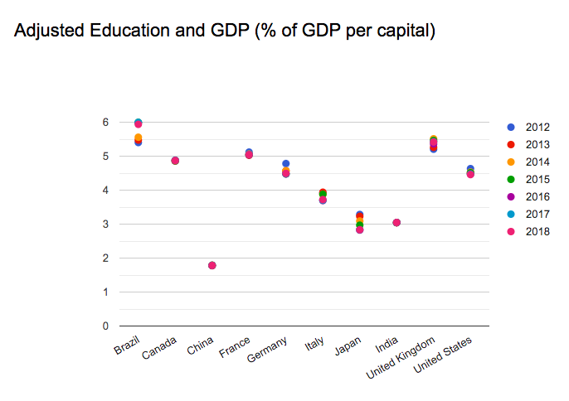
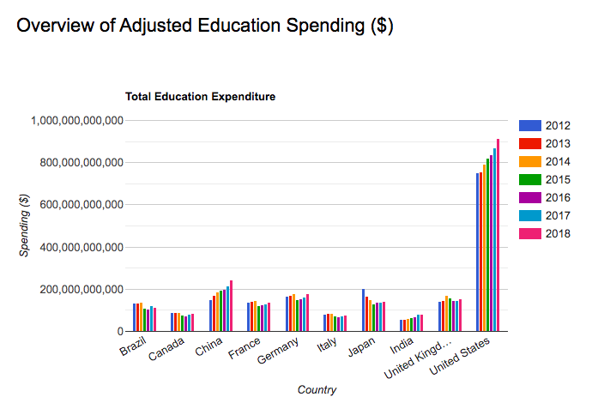
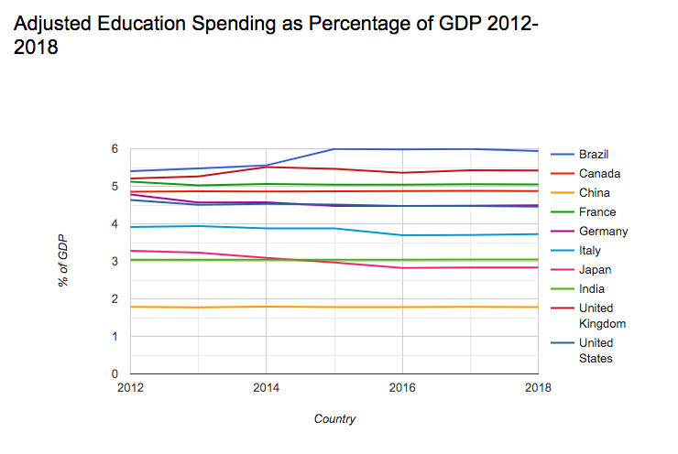
Education Spending

Slide 3
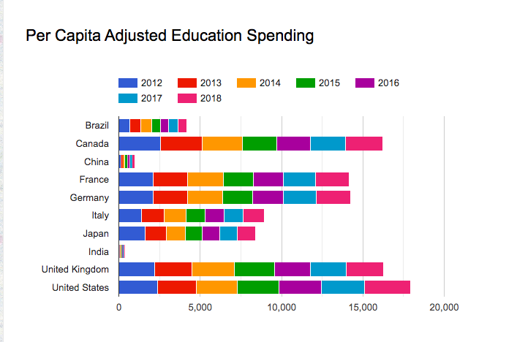
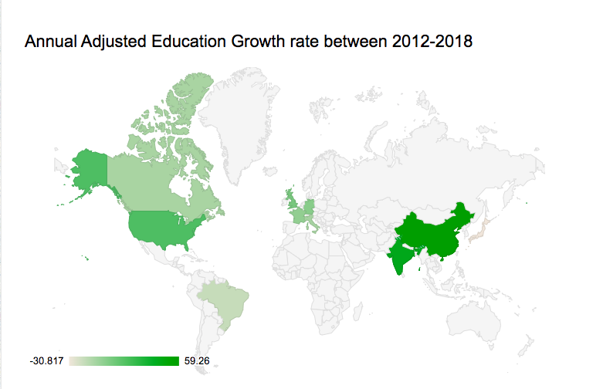

Slide 4
Conclusion
From 2012 to 2018,
The United States ranked top on overall educational expenditure.
Brazil ranked top on per capita educational expenditure.
Brazil spent the highest percentage of GDP on education.
China had the highest annual growth rate in education expenditure.

Slide 5
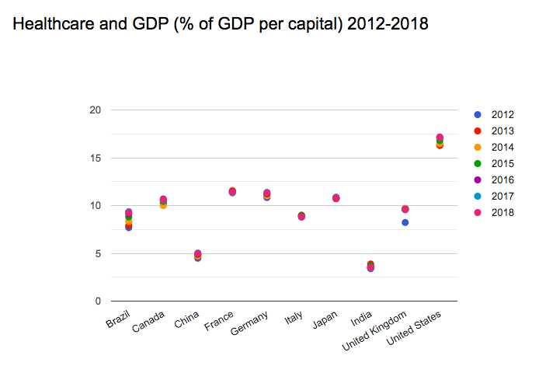
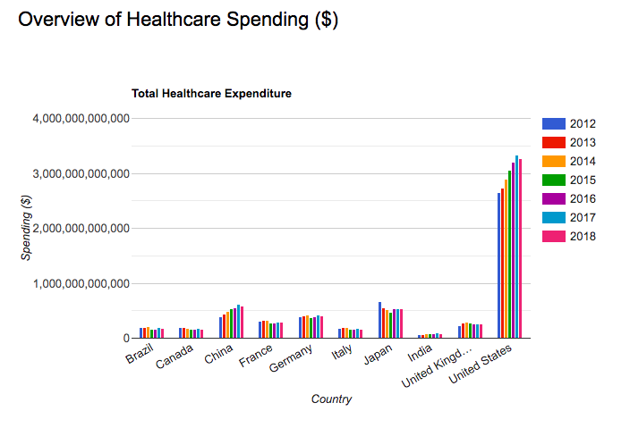
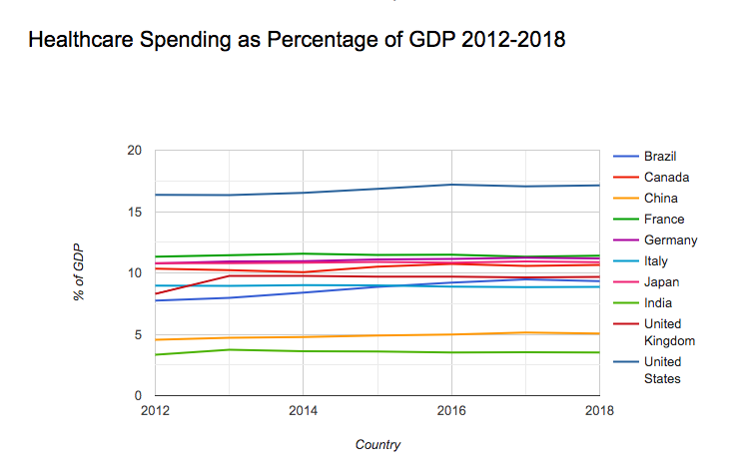
Healthcare Spending

Slide 6
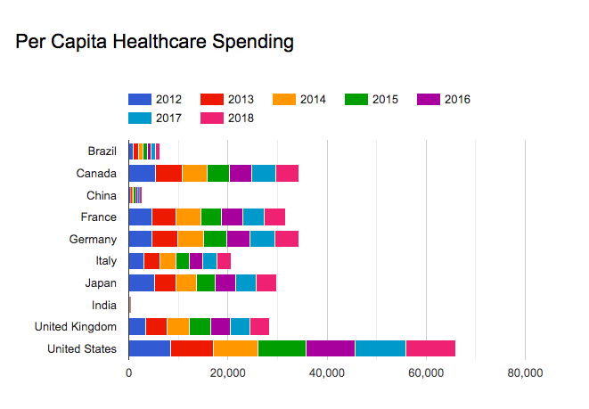
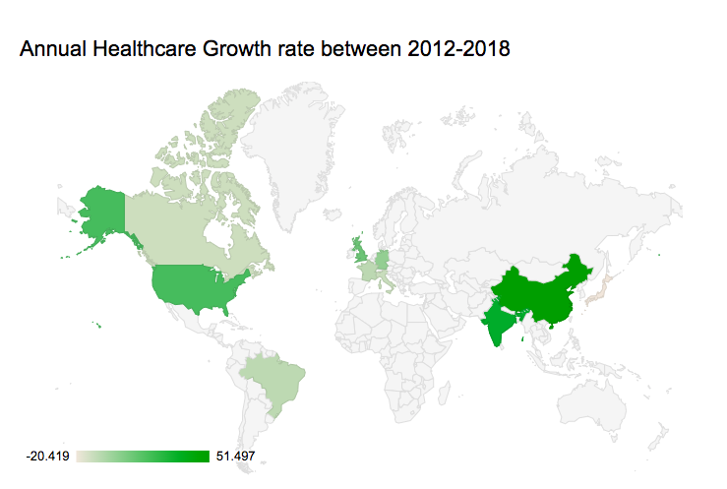

Slide 7
Conclusion
From 2012 to 2018, •
The United States ranked top on overall healthcare expenditure.
The United States ranked top on per capita educational expenditure.
China had the highest annual growth rate in healthcare expenditure.

Slide 8
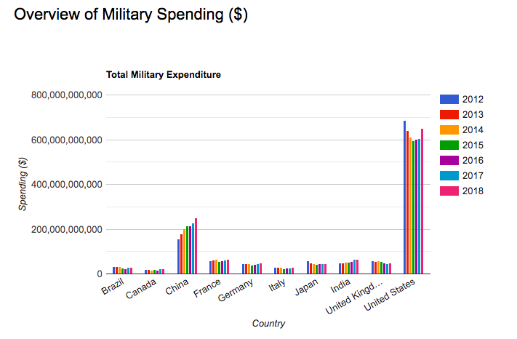
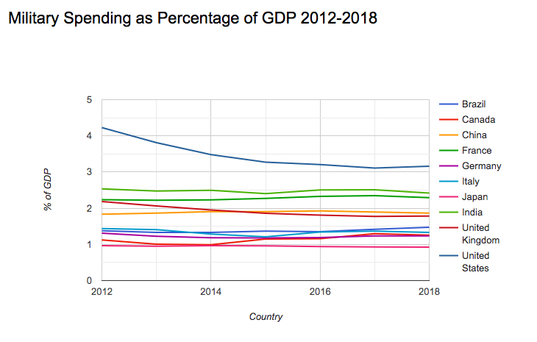
Military Spending

Slide 9
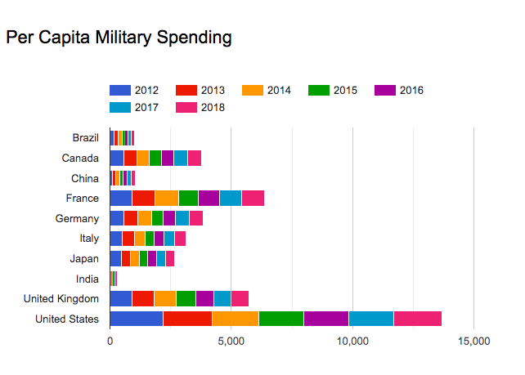
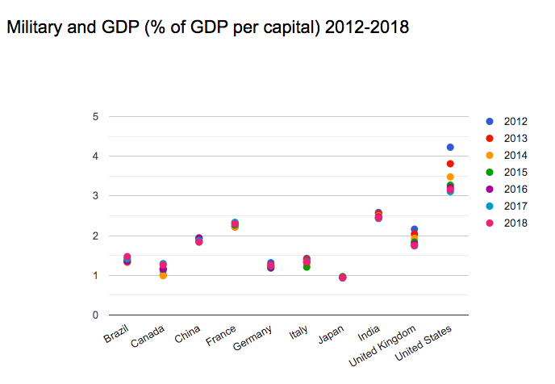

Slide 10
Conclusion
From 2012 to 2018,
The United States ranked top on overall military expenditure.
The United States ranked top on per capita military expenditure.
In 2016, the United States spent more on healthcare than on education and military.
Brazil decreased military expenditure.

Slide 11
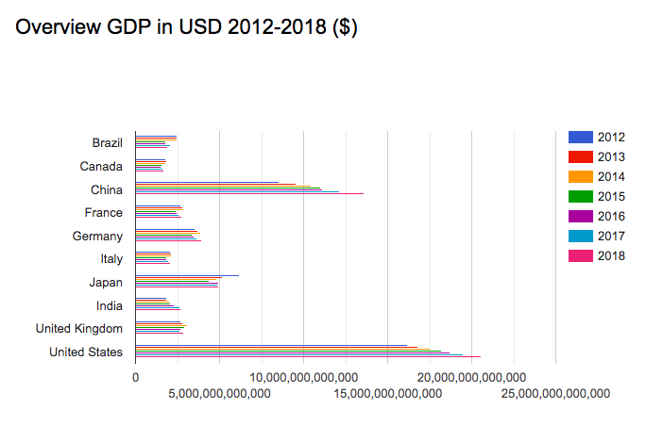
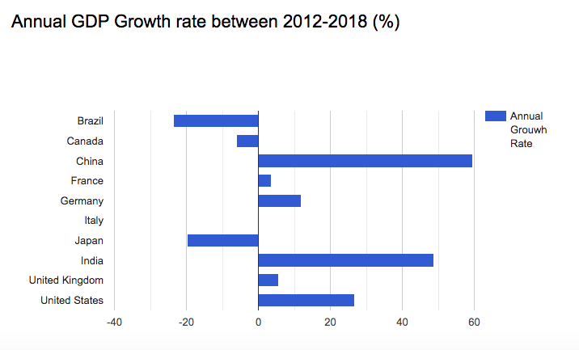
More analysis -GDP

Slide 12
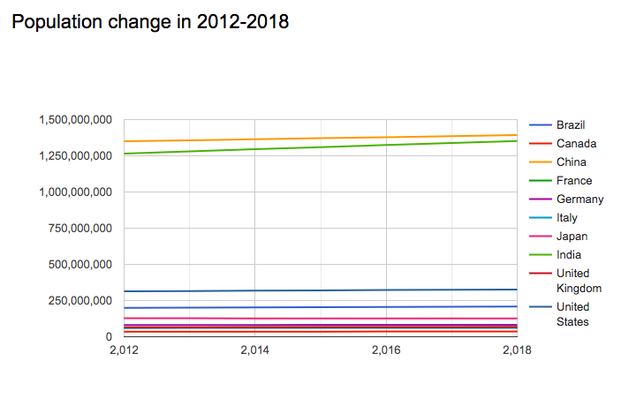
Population

Slide 13
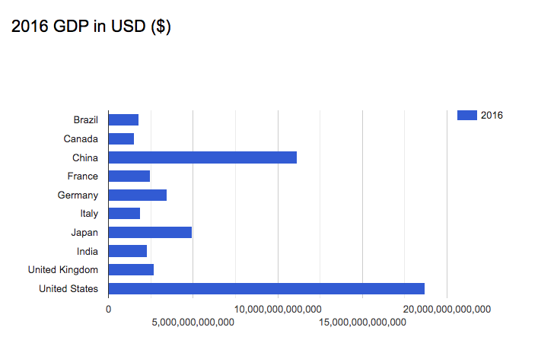
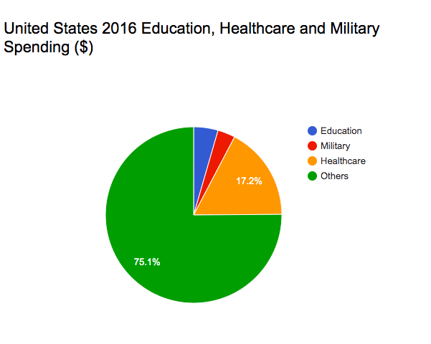
2016 GDP and United States spending

Slide 14
Thank you !

